Slide 1


Slide 2

Day 5: Agenda
Introduction to Model Evaluation
K-Fold Cross-Validation
Hyperparameter Tuning Using Grid Search
Classification Metrics Overview
Precision, Recall, and F1-Score
ROC Curves and AUC
Practical Interpretation and Usage

Slide 3
Model Evaluation Overview
Model evaluation helps assess how well a trained model performs on unseen data. It impacts model selection and performance optimization by allowing us to choose the best-performing model, tune hyperparameters, and avoid overfitting.
Model Selection:
Helps choose the best-fitting machine learning algorithm.
Guides the selection of optimal hyperparameters.
Enables comparisons between different models.
Performance Optimization:
Facilitates fine-tuning for better results.
Prevents overfitting by evaluating on unseen data.
Identifies and addresses issues like bias and underfitting.
Provides quantifiable metrics for tracking model improvements.

Slide 4
Cross-Validation
Cross-validation is a technique in machine learning that systematically divides data into multiple subsets to assess a model's performance.
Role:
Provides robust performance assessment.
Addresses overfitting and underfitting.
Optimizes hyperparameters.
Enhances model selection.
Addressing Train-Test Split Issues:
Reduces variability in performance evaluation.
Efficiently utilizes limited data.
Ensures diverse data assessment.
Cross-validation improves model reliability and evaluation compared to single train-test splits.

Slide 5
K-Fold Cross-Validation
Divides data into 'K' subsets, trains and evaluates the model 'K' times, each time using a different subset for validation.
Benefits:
Robust performance estimation.
Reduces variability.
Efficient data use.
Effective for hyperparameter tuning.
Facilitates model comparison.
Detects overfitting.
K-Fold Cross-Validation enhances model evaluation and is essential for robust machine learning model development.

Slide 6

K-Fold Cross-Validation

Slide 7
Question
Using the Titanic dataset, perform K-Fold Cross-Validation with K=5 and evaluate the performance of a Decision Tree classifier. Explain how this approach helps assess the model's performance.
Notes:
Note:- Use Jupyter file for this question - K-Fold Cross-Validation - Titanic Dataset.ipynb

Slide 8
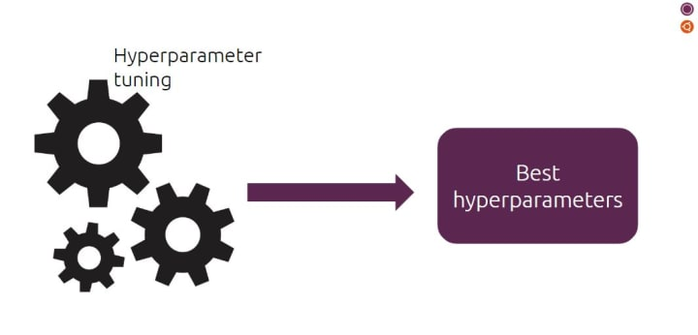
Hyperparameter Tuning
Importance: Hyperparameters are critical settings that significantly impact a model's performance, generalization, and stability.
Grid Search: Grid search is a systematic method for optimizing hyperparameters. It evaluates predefined combinations to identify the best settings, making it easy to use and interpret.

Slide 9
Grid Search Process
Hyperparameter Selection: Choose critical model settings for optimization.
Define Hyperparameter Ranges: Specify value ranges for each selected hyperparameter.
Grid Creation: Create a matrix of all possible hyperparameter combinations.
Model Training and Evaluation: Train models for each combination and evaluate using a chosen metric.
Select Best Hyperparameters: Identify the combination with the best performance.
Model Re-training: Train a final model with the best hyperparameters on the full dataset.
Model Evaluation: Assess the optimized model on a separate test dataset for generalization.

Slide 10
Grid Search Process
Selecting Hyperparameters and Ranges:
Identify critical hyperparameters based on model behavior.
Define appropriate value ranges guided by domain knowledge or experimentation.
Ensure ranges cover a broad spectrum for comprehensive exploration.

Slide 11
Question
Write Python code to perform Grid Search hyperparameter tuning for a Decision Tree classifier on the Titanic dataset (titanic.csv) using a 5-fold cross-validation (K=5). Your code should find the best hyperparameters for the Decision Tree model and print the results.
Notes:
Note:- Use Jupyter file for this question -Grid Search (Hyperparameter Turning) - Titanic Dataset.ipynb

Slide 12
Classification Metrics (Revision)
Common classification metrics beyond accuracy include:
Precision: The proportion of true positive predictions among all positive predictions. It measures the model's ability to avoid false positives.
Recall (Sensitivity or True Positive Rate): The proportion of true positive predictions among all actual positive instances. It assesses the model's ability to capture all positive instances.
F1-Score: The harmonic mean of precision and recall. It balances precision and recall and is useful when there is an uneven class distribution.
Specificity (True Negative Rate): The proportion of true negative predictions among all actual negative instances. It measures the model's ability to avoid false negatives.
Area Under the ROC Curve (AUC-ROC): A measure of a model's ability to distinguish between classes, particularly in imbalanced datasets. It considers different threshold levels.
Area Under the Precision-Recall Curve (AUC-PRC): Similar to AUC-ROC but focuses on the precision-recall trade-off, making it useful when there is a class imbalance.

Slide 13
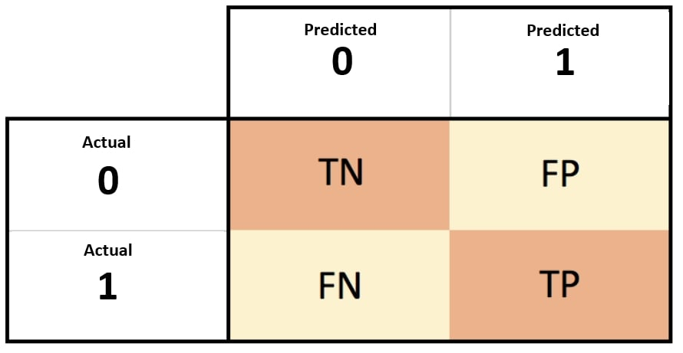
Confusion Metrics (Revision)

Slide 14
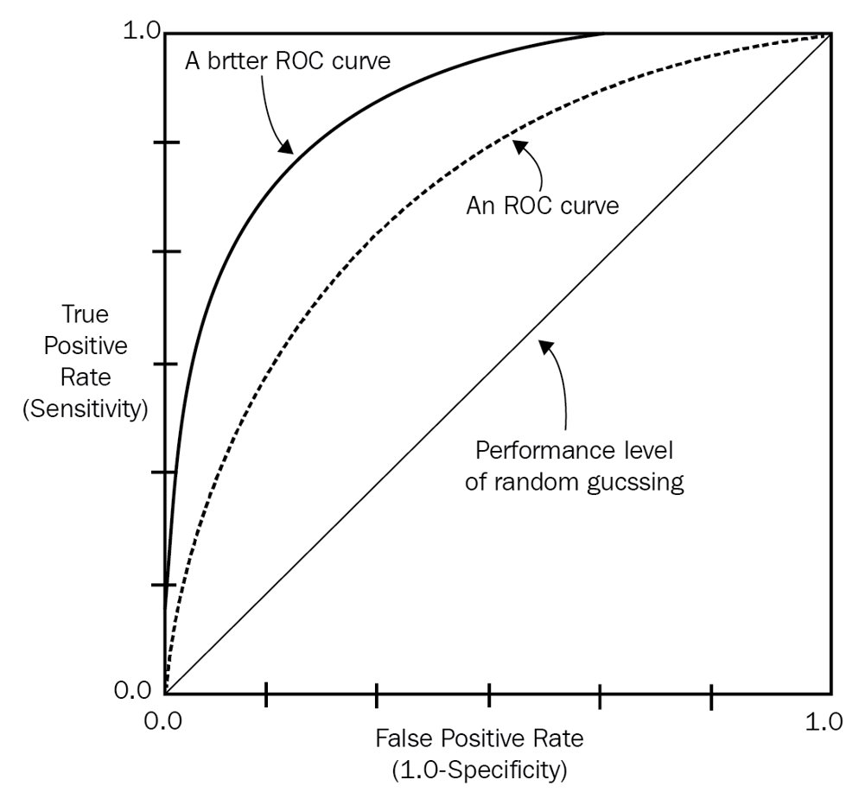
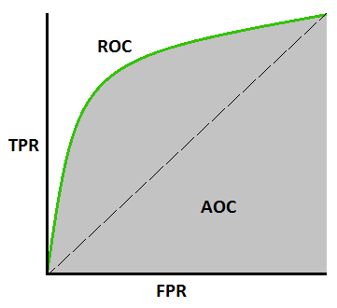
ROC & AUC

Slide 15
Questions
Using the built-in Breast Cancer dataset provided by scikit-learn, perform the following tasks:
Develop a machine learning model using K-Fold Cross-Validation to evaluate its performance.
Implement Grid Search for hyperparameter tuning to optimize the model.
Compare the performance of the initial model and the tuned model, and provide insights based on the results.
Share your findings and conclusions from this analysis.
Notes:
Note:- Use Jupyter file for this question - Model Evaluation - Breast Cancer Dataset.ipynb

Slide 16
Questions ?

Slide 17
Thank You !

